Slide 1
Take the PREP Survey
11th Grade
Advisory Activity

Slide 2
Take the PREP
Be honest
In order to get an accurate profile of your personal readiness, answer truthfully

Slide 3
Score the PREP
Count the number of each type of response you gave on the PREP and record it in the chart.
Then, color in the boxes according to the directions for each response.
Do this for each set of questions

Slide 4
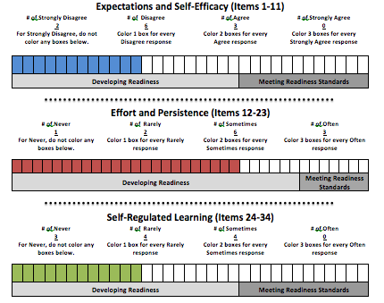
Personal Readiness Profile
Completed scoring shows a profile of personal readiness.
Each colored bar represents readiness in that area

Slide 5
Expectations and Self-Efficacy
These items are about your belief in yourself and your ability to be successful in college.
This student is developing readiness in this area.
She needs to work on building belief in her ability to be successful in school and in college.

Slide 6
Effort and Persistence
These items are about how much effort or hard work you are willing to put into your schoolwork and how much you persist, or keep trying, in the face of challenges.
This student is developing readiness in this area.
She needs to work on developing strategies to keep trying her best, even when things get difficult or boring.

Slide 7
Self-Regulated Learning
These items are about the strategies you use to manage your own learning – like setting goals, managing your time, and using study strategies. College requires you to be an independent learner – you are responsible for your own learning.
This student is developing readiness in this area.
She needs to work on developing strategies to manage herself and her learning.

Slide 8
Next Advisory
Students will use their PREP results to:
Identify ways to build on their strengths
Identify ways to improve on their biggest areas of need

