Slide 1
Checking Account

Slide 2
Directions
1. Bought diapers/formula from Target - $55.14; wrote check #101
2. Purchased $127. 56 groceries from Super Valu; paid with debit card
3. Fill out Deposit Slip and deposit check from part-time job for $75.00

Slide 3
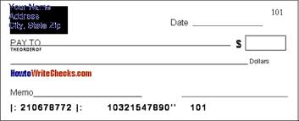
Check

Slide 4
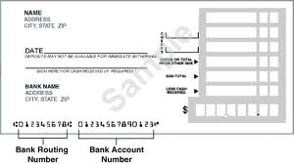
Deposit Slip

Slide 5
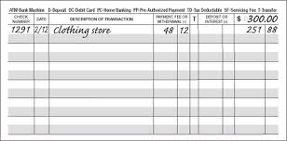
Register

Slide 6
Total
$144.18

Slide 7
Reality Store How well will you do living for a month on your intended salary?
You will need to buy a car and a house, purchase insurance, make investments, pay bills, and complete other activities as life requires.
The goal is to leave the day with a positive balance in your account equal to 10% of your monthly income.

Slide 8
Reality Store Checklist
meet in Gathering Room by 8:20; sit in advisory groups
dress as your profession would require
(no bad jeans)
bring: calculator, pen/pencil, i.d./proof of address

Slide 9
you will be issued a student checklist, your life status (married, divorced, kids), and your first paycheck
fill out a deposit slip
in the gym, visit the banking booths first to open an account and receive your checkbook and debit card
you can proceed to any of the other booths in random order, but you must visit all booths before you check-out at the end

Slide 10
in order to leave, you need to have a checkbook balance that is 10% of your total monthly income as reported on your life status sheet
Questions?

